Slide 1
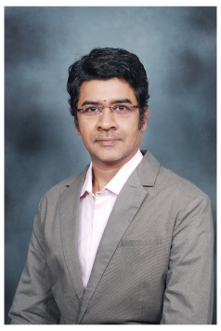
Vijayanand Subramanian
COO
Navigating the evolving landscape :
27 years of cross-functional expertise in Banking Operations, Core Banking technology, Risk Management, Cyber Security, Product Development, and Data Privacy.
Cyber Resilience Champion: Leading a Cyber Security & Insurtech firm focused on risk management and building organizational cyber resilience.
Pioneering Insurtech & Cybersecurity Solutions: Developed innovative products to address ransomware, catastrophic cyber risks, and their financial impact. Providing visibility to Board of Directors-and C-level
Quantifying Cyber Risk: Developed CYBERCAT™, a globally recognized non-linear model for cyber risk quantification in 2017 and CASUALTYCAT ™ for quantifying management level risk.
Extensive Experience: Conducted cyber security controls audits as per regulatory framework, risk assessments, and quantifications for large financial institutions and critical infrastructure. Proven track record in building cyber maturity levels and enabling risk transfer across diverse industries (BFSI, Telecom, Power, logistics, Oil & Gas, Realty, Manufacturing, etc.) in India, Sri Lanka, Bangladesh, and UAE.
Cyber Risk Consulting - Critical infrastructure – Assessment methodology and coverage for operational technology. (Power and Oil-Gas.) and Vciso professional services.
Trusted Partner: Successfully delivered large-scale IT projects for leading public sector undertakings, foreign banks, and IT giants (Infosys, Oracle Financial services, Scope Intl, Bahraini Saudi Bank, First International Merchant Bank, Bank of India & BOB Mauritius)
Areas of Practice
Insurtech solutions – Managing Risks
Cyber Risk Assessment & Quantification
Cybercat Modelling – Research oriented
Ransomware
Operational Technology
Cyber Claim forensics
Academic Journey
Harvard University - Cyber Security - Managing Risk in Information Age.
Cyber Security – Foundation – National Institute of Securities Markets - Cert-in, C-dac, Csirt. (SEBI initiative)
Risk Management – RMAI-AICP London.
DSCI-Certified Privacy Lead Assessor(DCPLA)
Diploma in Cyber law, Fintech Regulations and Technology Contracts.
Graduated in Law - LLb
Masters in Commerce,
Executive-MBA

